Slide 1
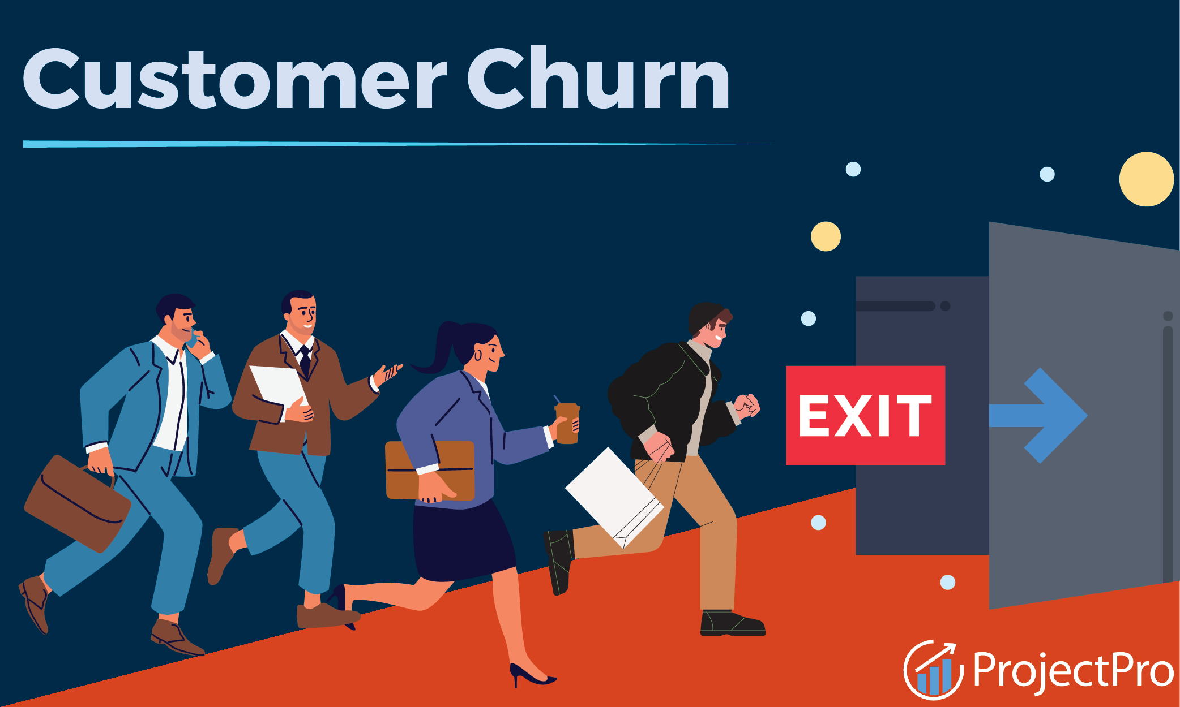
predicting and mitigating customer churn
for Telecommunication network
By Isaac Mensah Twum

Slide 2

Agenda
Business problem
Data source and cleaning
erd
Sql codes and results
visualizations
Recommendations

Slide 3
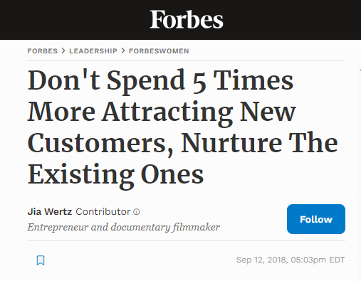
As a Business Intelligence analyst, I decided to identify some of the reasons why a customer would exit from a telecommunication network.
The goal of this project is to identify customers who are likely to cancel their subscriptions, thereby allowing for the implementation of proactive measures to encourage customer continued loyalty.
This is relevant because customer churn is a critical issue for businesses, especially in banking and subscription-based businesses, leading to revenue loss and increased acquisition costs.
It is more cost-effective for businesses to identify and retain at-risk customers than acquiring new ones.
Business Problem

Slide 4
What is the tenure range for customers who churned?
What percentage of revenue does this Telco lose due to churned customers?
What are the top 10 cities with the highest churn rates?
What are the top reasons why customers leave?
What Internet Type did churners have?
Did churners have premium tech support?
What contract were churners on?
Business Questions considered

Slide 5
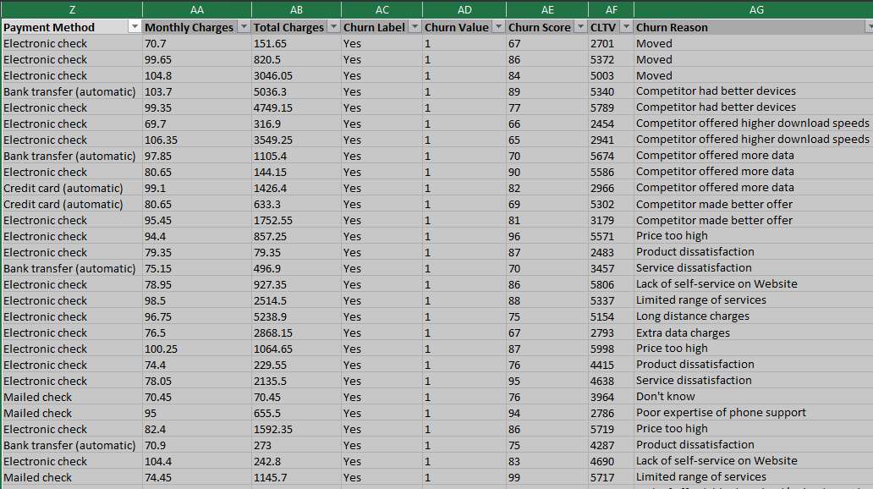
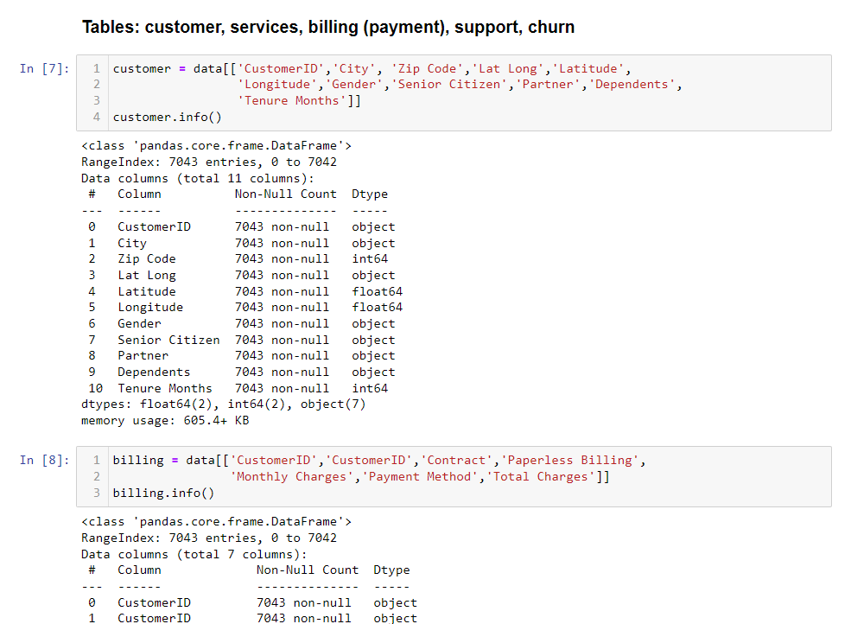
Data Source and Cleaning
To solve this problem, I use the "Telco Customer Churn" dataset from Kaggle, a telecommunication network based in California.
An Excel file with 33 variables and 7043 observations
This dataset contains customer information such as subscription details, billing details, customer demographics, churn status, and telecoms customer support.
I used Jupyter Notebook to divide the dataset into five tables: Customer, Billing, Subscription, Support and Churn tables.
The customer ID served as both the primary key and the foreign key for the tables since this is the only column that corresponds to each customer's unique details.

Slide 6
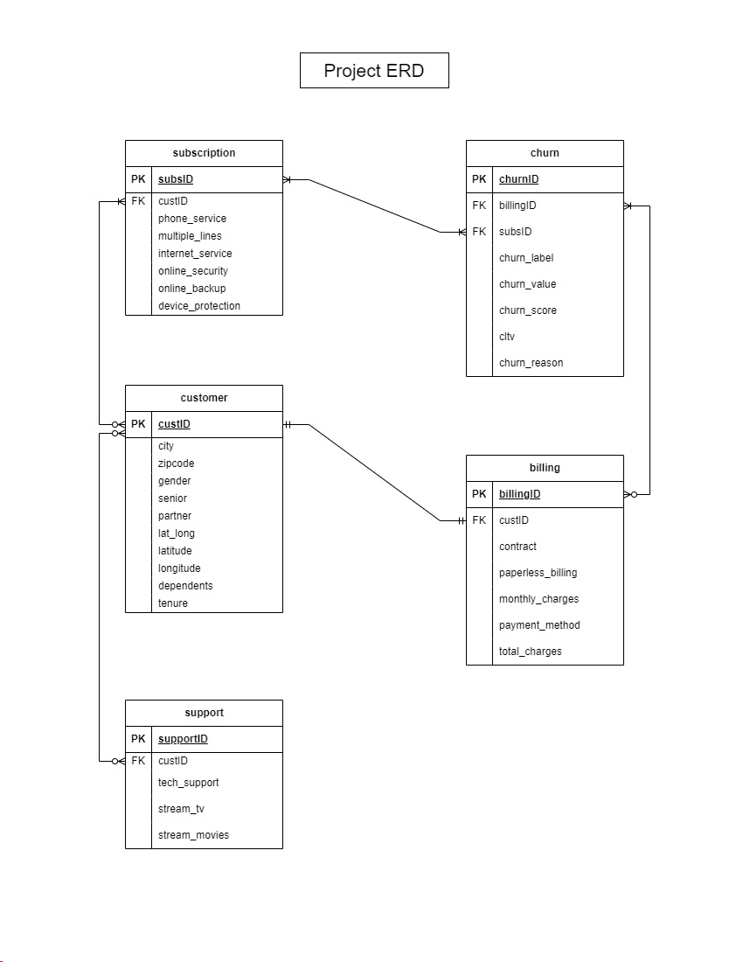
ERD
Before uploading to MySQL which is the database used, I used an Entity Relationship Diagram to link the tables in the database.
A customer must have at least one subscription.
Subscription can be in the customer table or not.
Customers and billing table have one and only one relationship.
There is a one-to-many relationship between subscription and churn table.
All customers are in the churn table, either one’s churn status is yes or no

Slide 7
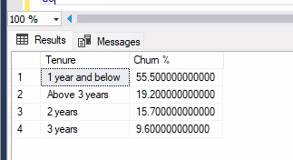
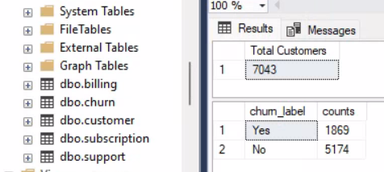
SQL Codes and Results
1. Tenure range for customers who churned
Total number of customers and total number of churn.
I used SQL CASE statement to group the customers
Insight: About 55.5%, a little above half, of the customers who churn, are below one year of subscription.

Slide 8
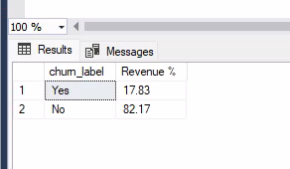
SQL Codes and Results
2. What percentage of revenue did Telcos lose due to churned customers?
Customer churn impacts revenue, emphasizing the need for effective retention strategies
Insight: About 18% of the Telcos revenue was lost due to customers who exited.

Slide 9
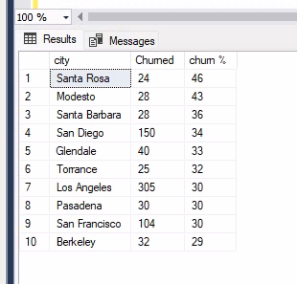
SQL Codes and Results
3. Top 10 cities with the highest churn rates.
Used CEILING statement to round to whole numbers and a JOIN statement to join customer and join table
Insight: These are cities with more than 20 customers. Santa Rosea is the highest with 46% churn rate.

Slide 10
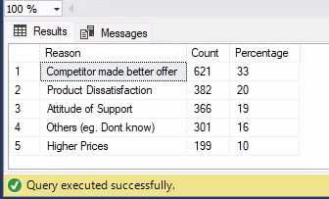
SQL Codes and Results
4. Top reasons why customers leave.
SQL CASE, WHEN, and LIKE statements to group the reasons
Insights: Top reasons were better offers from competitors and product dissatisfaction from customers.
Attitude of their customer support service is also another major reason for churning.

Slide 11
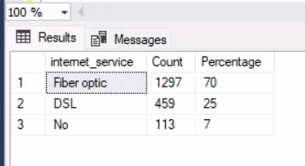
5. What Internet Type did churners have?
Insight:
70% of the churners are on Fiber optic internet.

Slide 12
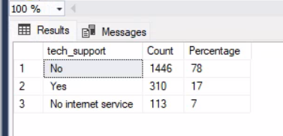
6. Did churners have premium tech support?
This field indicates customers who subscribed to additional tech support.
Insights:
78% did not subscribe to any additional support
Since tech support was part of the top reasons, it might be that customers were not willing to subscribe to additional support.

Slide 13
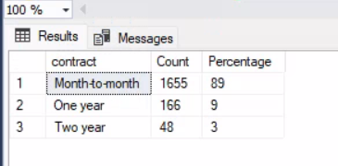
7. What contract were churners on?
Insight:
89% of customers are on a monthly subscription. The majority of customers prefer flexibility in their subscription plans.

Slide 14
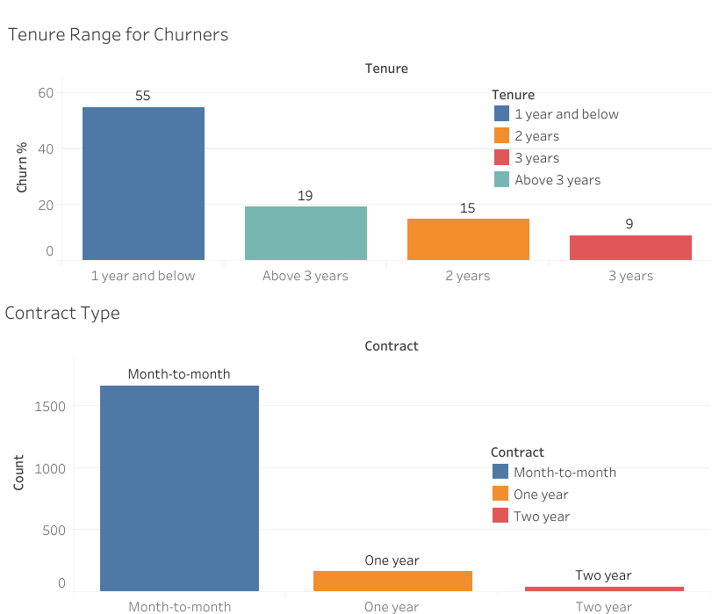
VISUALIZATIONS

Slide 15
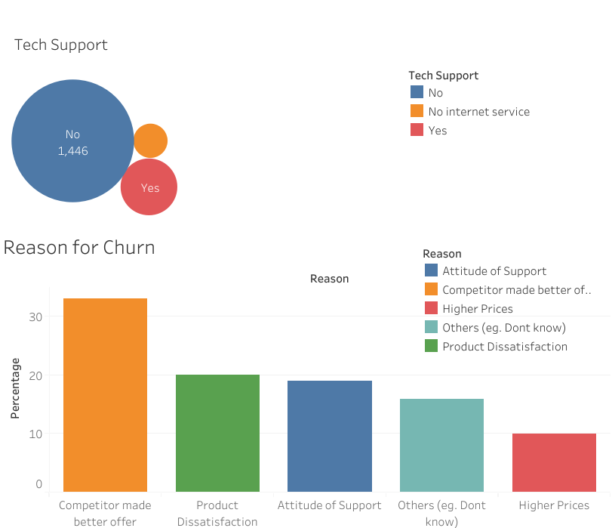
VISUALIZATIONS

Slide 16
Recommendations
Increasing Customer Retention or Loyalty
Incentives to encourage long-term commitments.
Through offering locked phone discounts to keep customers beyond a year.
Reducing the 89% month to month rate
Market analysis in cities with higher churn rate
City-Specific Market Insights
Customer feedback collection to gain insights into local preferences
Improving Product/Internet Service
Analyzing competitor offerings
Value-added services to counter competitor incentives
Explore opportunities for better pricing
Improve customer support
Premium tech support for all customers, from 17% to 100% access for all
Training their customer support personnel
Customer feedback

Slide 17
THANK
YOU
Q & A?
Isaac Twum
twumim@appstate.edu

